Slide 1
Chap. 02 Linear Time-Invariant Systems

Slide 2
Many physical processes can be represented by, and successfully analyzed with, linear time-invariant (LTI) systems as models.
LTI models are also extremely useful for design. A process control engineer would typically design a level controller for the mixing tank based on a set of linearized, time-invariant differential equations.

Slide 3

DISCRETE-TIME LTI SYSTEMS: THE CONVOLUTION SUM
We will see that the convolution sum is the mathematical relationship that links the input and output signals in any linear time-invariant discrete-time system. Given an LTI system and an input signal x[n], the convolution sum will allow us to compute the corresponding output signal y[n] of the system.
Representation of Discrete-Time Signals in Terms of Impulses
A discrete-time signal x[n] can be viewed as a linear combination of time-shifted impulses:

Slide 4
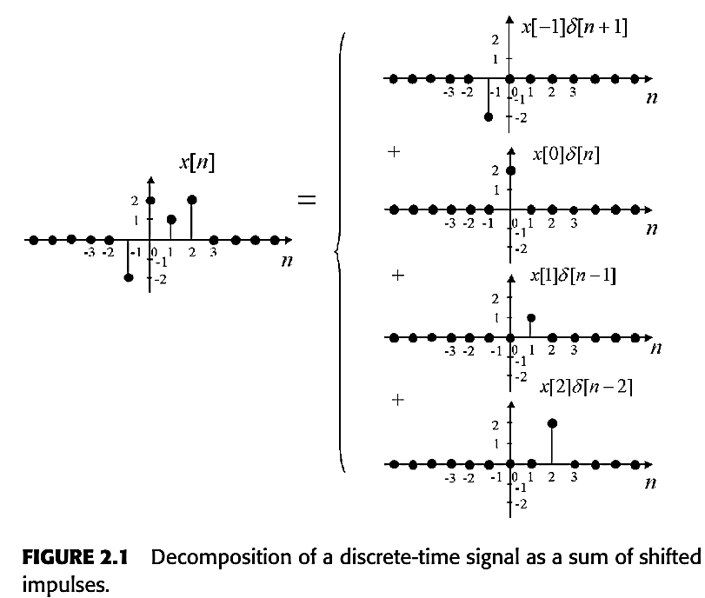
Example 2.1:
The finite-support signal x[n] shown in Figure 2.1 is the sum of four impulses.
Thus the signal can be written as
x[n] = -2δ[n+1]+2δ[n]+δ[n-1]+2δ[n-2]

Slide 5
Response of an LTI System as a Linear Combination of Impulse Responses
By the Principle of Superposition, the response y[n] of a discrete-time linear system is the sum of the responses to the individual shifted impulses making up the input signal x[n].
Let h_{k}[n] be the response of the LTI system to the shifted impulse δ[n-k].

Slide 6
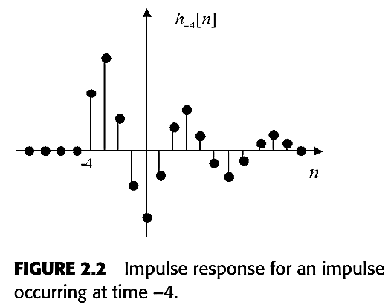
Example 2.2: For k = -4, the response h₋₄[n] to δ[n+4] might look like the one in Figure 2.2.

Slide 7

Example 2.3: For the input signal x[n] = -2δ[n+1]+2δ[n]+δ[n-1]+2δ[n-2]
in Example 2.1, the response of a linear system would be
y[n] = -2h₋₁[n]+2h₀[n]+h₁[n]+2h₂[n].
Thus, the response to the input x[n] can be written as an infinite sum of all the impulse responses:

Slide 8
It gets better than this: for a linear time-invariant system (the time-invariance property is important here), the impulse responses h_{k}[n] are just shifted versions of the same impulse response for k = 0:
Therefore, the impulse response h[n]:= h₀[n] of an LTI system characterizes it completely. This is not the case for a linear time-varying system: one has to specify all the impulse responses h_{k}[n] (an infinite number) to characterize the system.

Slide 9


The Convolution Sum
The Convolution Operation
More generally, the convolution of two discrete-time signals v[n] and w[n], denoted as v[n] * w[n] (or sometimes (v * w)[n] ), is defined as follows:

Slide 10
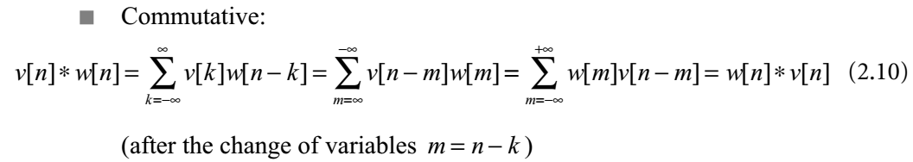
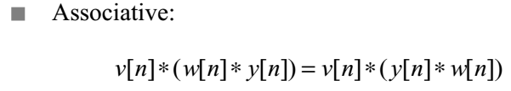
The convolution operation has the following properties. It is

Slide 11
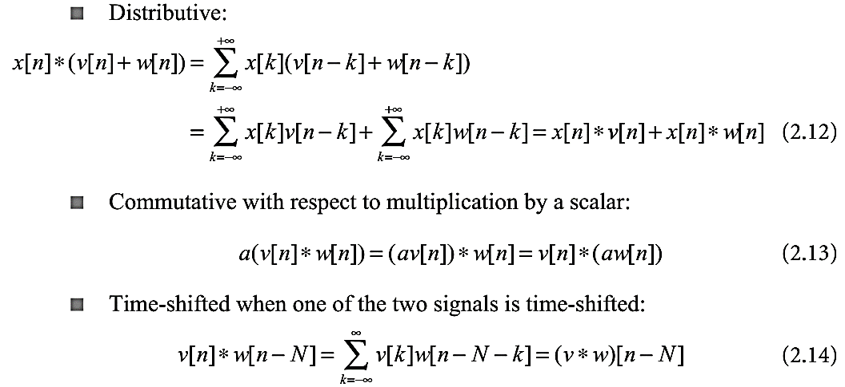

Slide 12
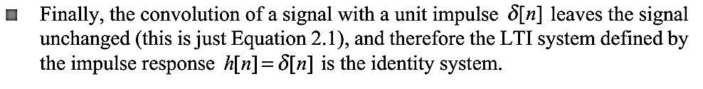

Slide 13
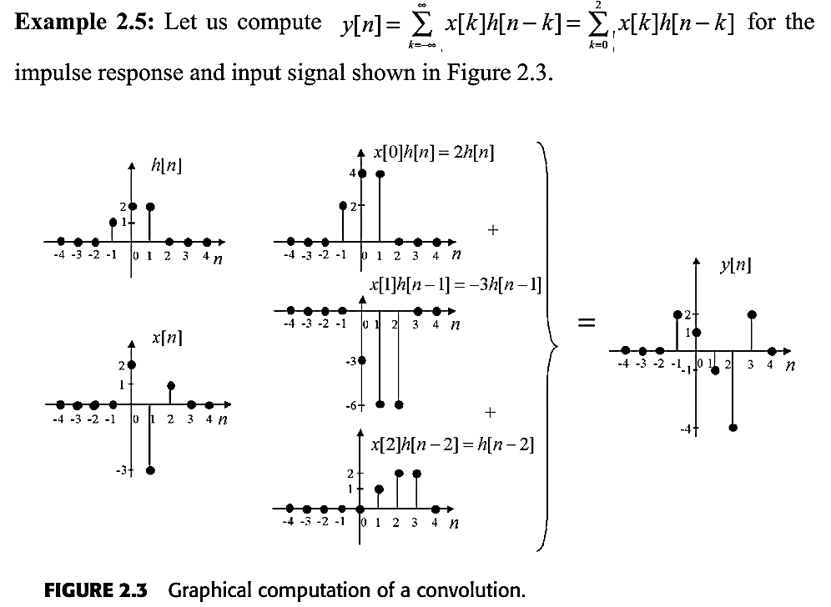
Graphical Computation of a Convolution

Slide 14
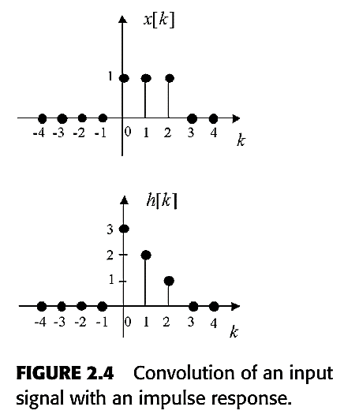
Example 2.6: Let us compute y[0] and y[1] for the input signal and impulse response of an LTI system shown in Figure 2.4
FIGURE 2.4 Convolution of an input signal with an impulse response.

Slide 15
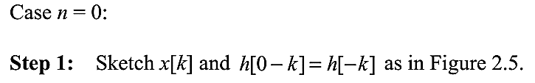
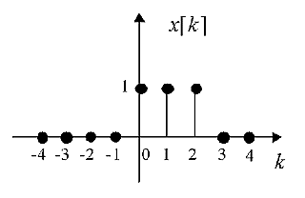
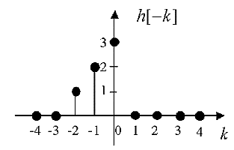
FIGURE 2.5 Impulse response flipped around the vertical axis.

Slide 16
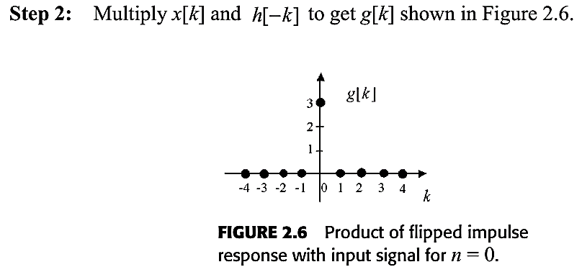
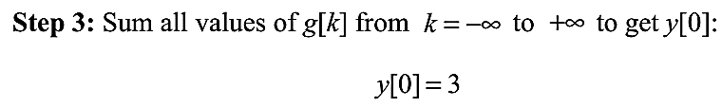

Slide 17
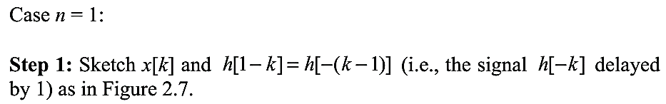
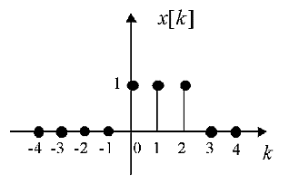
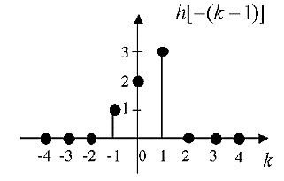
FIGURE 2.7 Time-reversed and shifted impulse response for n = 1.

Slide 18
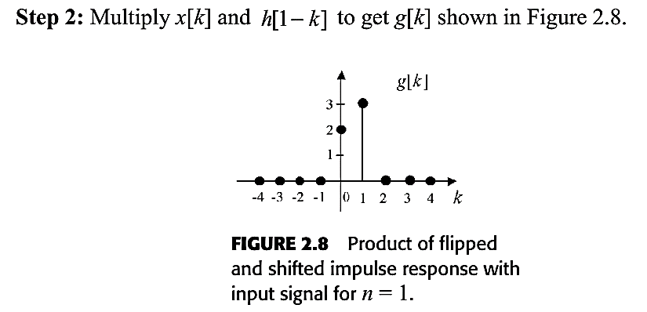
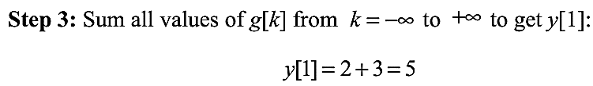

Slide 19
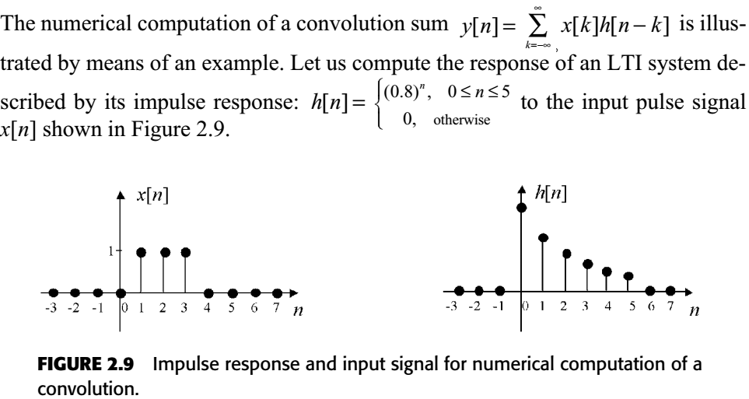
Numerical Computation of a Convolution

Slide 20
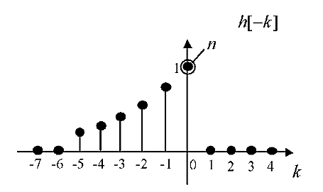
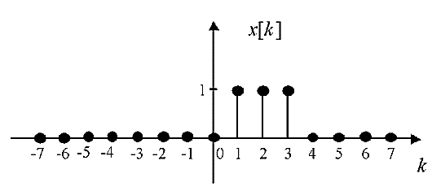
First, we sketch and x[k], one above the other as shown in Figure 2.10,
FIGURE 2.10 Time-reversed impulse response and input signal for numerical computation of a convolution.

Slide 21
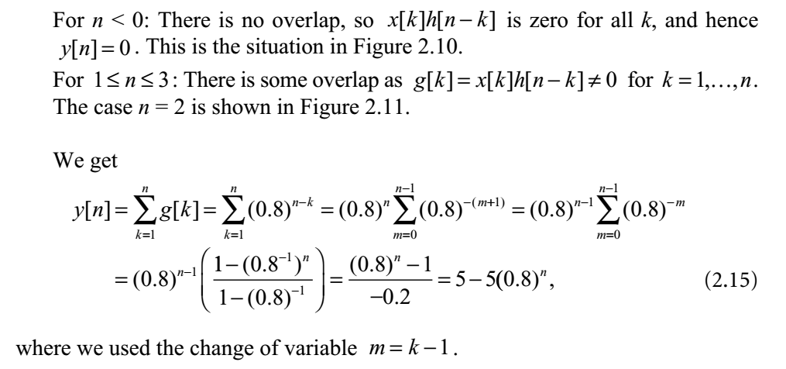

Slide 22
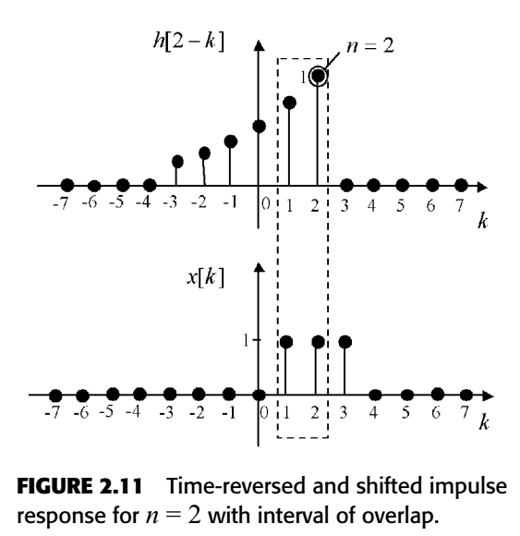

Slide 23
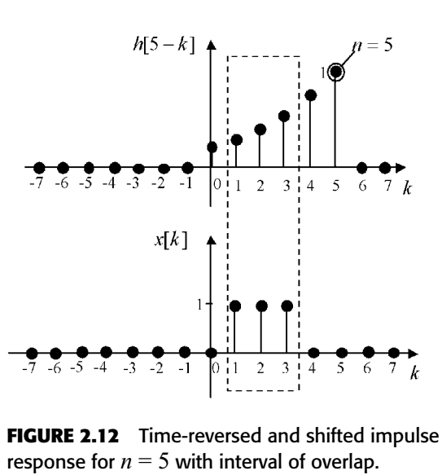

Slide 24
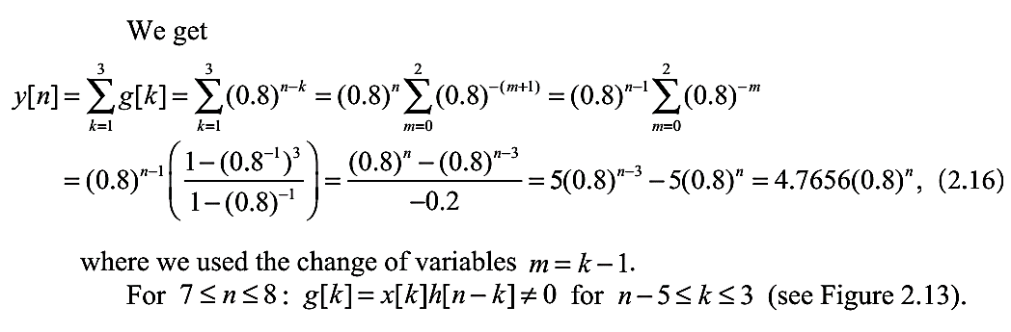

Slide 25
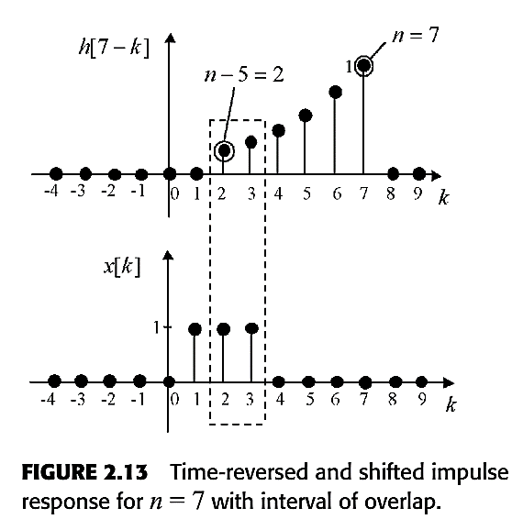

Slide 26
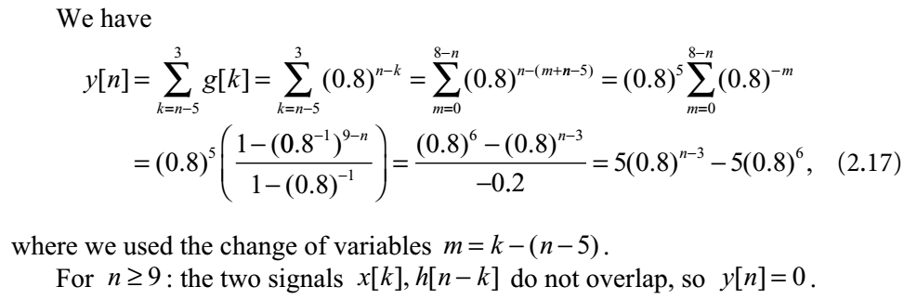

Slide 27
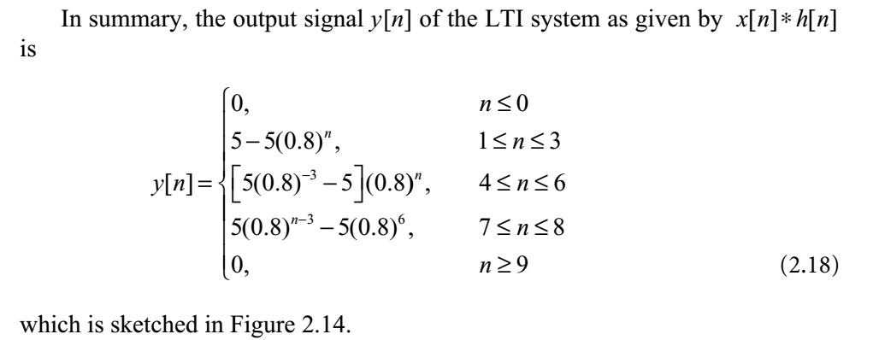

Slide 28
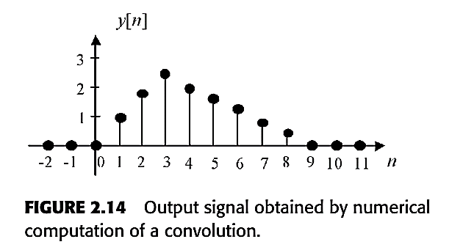

Slide 29

CONTINUOUS-TIME LTI SYSTEMS: THE CONVOLUTION INTEGRAL
Representation of Continuous-Time Signals in Terms of Impulses
A continuous-time signal x(t) can be viewed as a linear combination of a continuum of impulses (an uncountable set of impulses infinitely close to one another):
We arrive at this result by “chopping up” the signal x(t) in sections of width Δ as shown in Figure 2.15 and taking the sum in Equation 2.20 to an integral as Δ → 0.

Slide 30
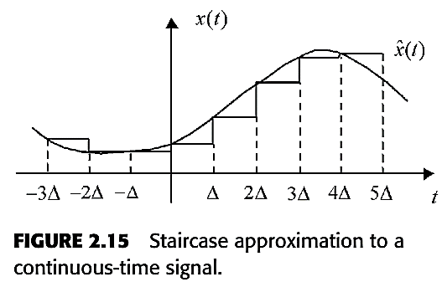

Taking the limit as Δ → 0, we obtain the integral of Equation 2.19 above.

Slide 31
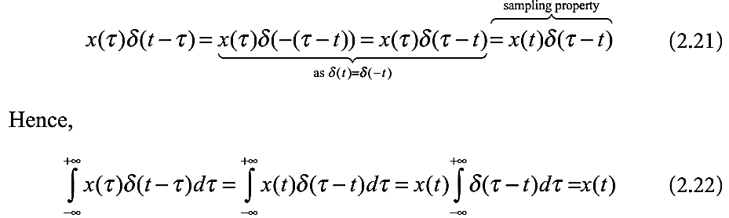

Slide 32

Impulse Response and the Convolution Integral Representation
of a Continuous-Time LTI System
the response of the LTI system S is given by the convolution integral
Note that an LTI system is completely determined by its impulse response.

Slide 33

The Convolution Operation
The convolution of v(t) and w(t), denoted as , v(t) * w(t),
or sometimes (v* w)(t), is defined as follows:

Slide 34
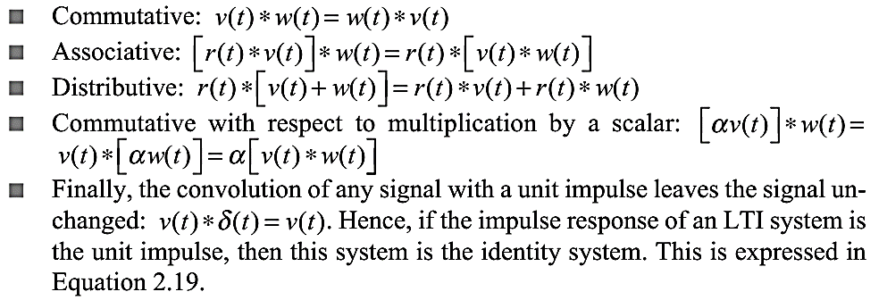
The convolution operation is

Slide 35
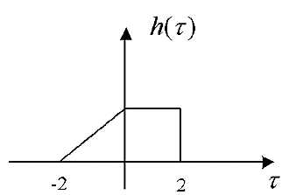
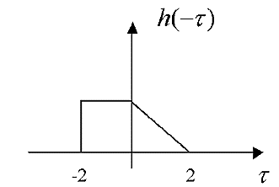
Calculation of the Convolution Integral
Example 2.7: Given h(τ) in Figure 2.16, sketch h(t-τ) for and t = 2.
FIGURE 2.16 Impulse response of a continuoustime system.
FIGURE 2.17 Time-reversed
impulse response.

Slide 36
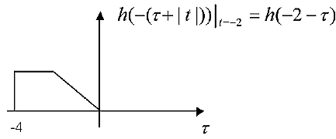
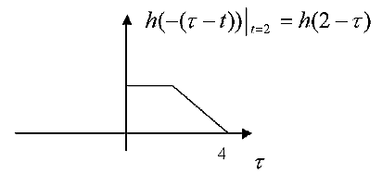
FIGURE 2.18 Time-reversed impulse
response shifted to the left.
FIGURE 2.19 Time-reversed impulse response shifted to the right.

Slide 37
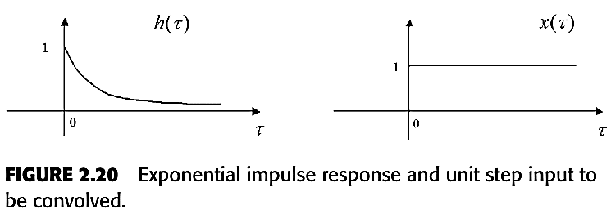
A convolution example
Compute the response of a continuous-time LTI system described by its impulse response h(t) = e^{-at}u(t), a > 0 to the step input signal x(t) = u(t), as shown in Figure 2.20.

Slide 38
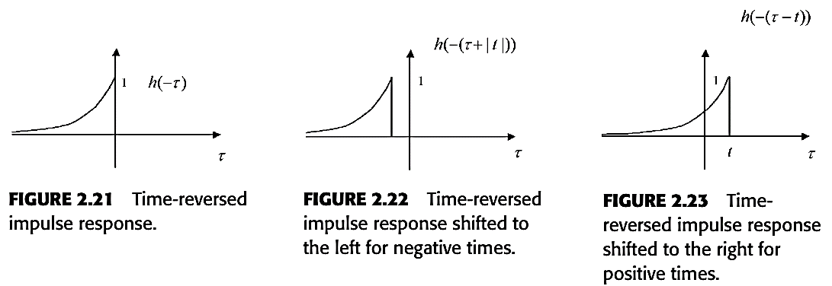
Solution:

Slide 39
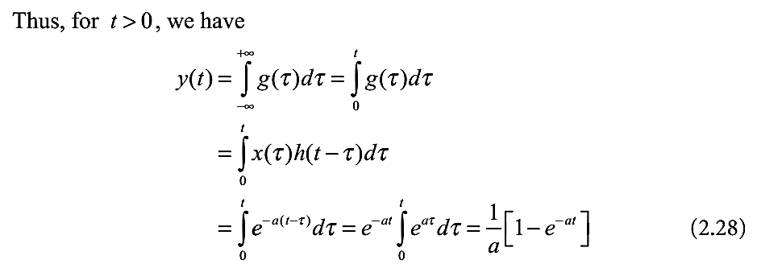

Slide 40
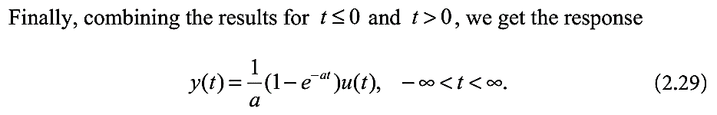
Example 2.8: We want to calculate the response of the continuous-time LTI system described by its impulse response h(t) = u(t+1) to the input signal x(t) = -e^{2(t-1)}u(-(t-1)) (see Figure 2.24).

Slide 41
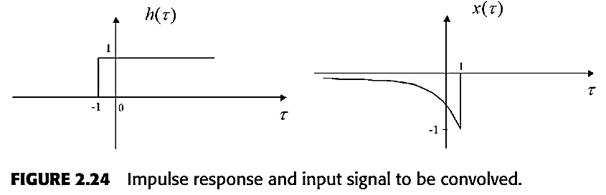

Slide 42
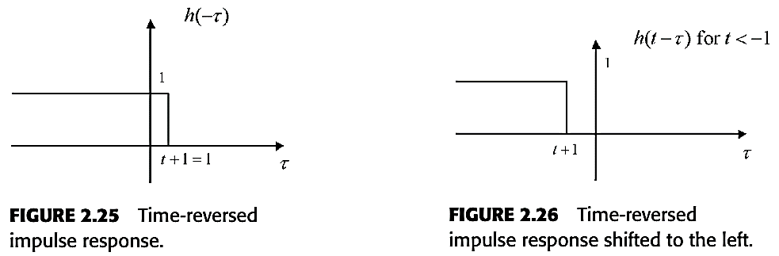
Solution:

Slide 43
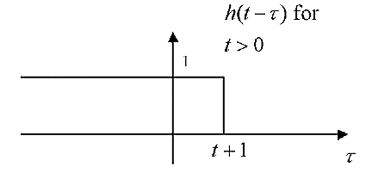
FIGURE 2.27 Time-reversed impulse response shifted to the right.

Slide 44
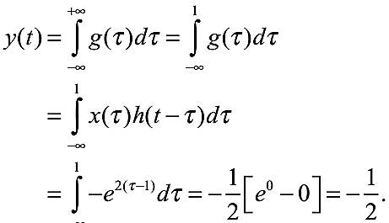
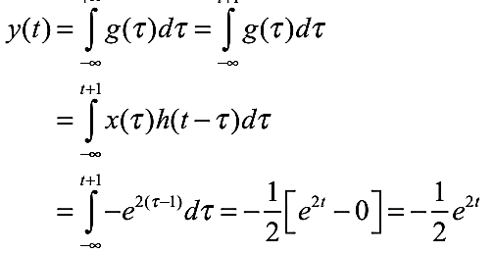

For t ≦ 0, For t > 0,
Piecing the two intervals together we obtain the response

Slide 45
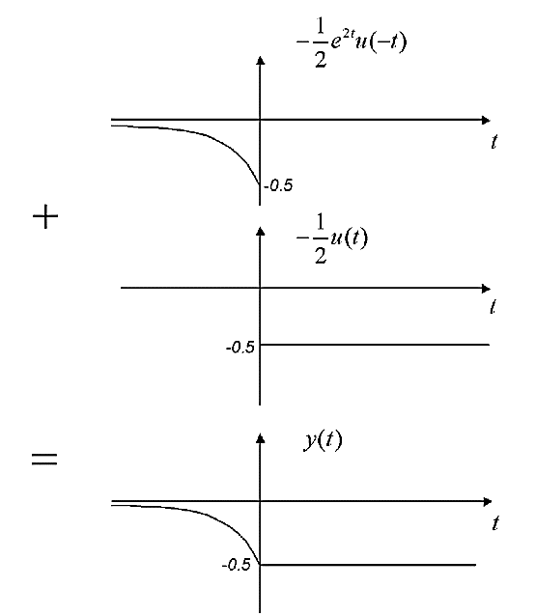
This sum of two signals forming the output is illustrated in Figure 2.28.
FIGURE 2.28 Overall response of the LTI system as a sum of two signals

Slide 46
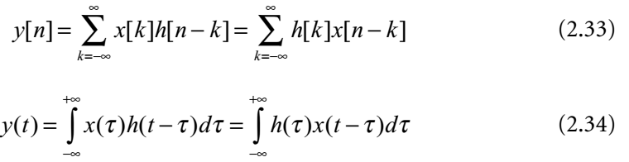
PROPERTIES OF LINEAR TIME-INVARIANT SYSTEMS
The Commutative Property of LTI Systems
The output of an LTI system with input x and impulse response h is identical to the output of an LTI system with input h and impulse response x, as suggested by the block diagrams in Figure 2.29.

Slide 47
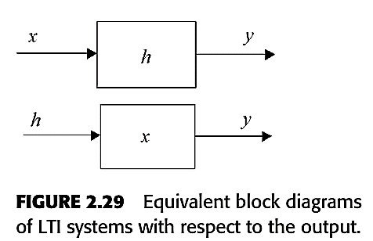

Slide 48
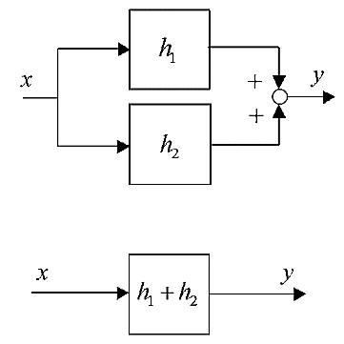
The Distributive Property of LTI Systems
FIGURE 2.30 System equivalent to a
parallel interconnection of LTI systems.

Slide 49
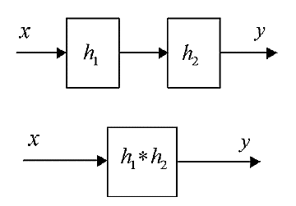
The Associative Property of LTI Systems
FIGURE 2.31 System equivalent to a cascade interconnection of LTI systems.

Slide 50
LTI Systems Without Memory
For an LTI system, this property can only hold if its impulse response is itself an impulse.
Thus, to be memoryless, a continuous-time LTI system must have an impulse response of the form h(t) = Aδ(t), and a discrete-time LTI system must have an impulse response of the form h[n] = Aδ[n]. The LTI system has memory otherwise.

Slide 51

Invertibility of LTI Systems
For an LTI system with impulse response h, this is equivalent to the existence of another system with impulse response h₁ such that h*h₁ = δ, as shown in Figure 2.32.

Slide 52

Causality of an LTI System
A continuous-time LTI system is causal if and only if h(t) = 0, t < 0.
A discrete-time LTI system is causal if and only if its impulse response is zero for negative times, i.e. h[k] = 0, for k < 0.
BIBO Stability of LTI Systems

Slide 53

The Unit Step Response of an LTI System
For a discrete-time system with impulse response h[n], the step response is s[n] = u[n]*h[n] = h[n]*u[n]. This convolution can be interpreted as the response of the accumulator system with impulse response u[n] to the signal h[n]. Hence, the step response of a discrete-time LTI system is just the running sum of its impulse response:
Conversely, the impulse response of the system is the output of the first-difference system with the step response as the input:

Slide 54


For a continuous-time system with impulse response h(t), the step response is is s(t) = u (t) *h (t) = h (t) *u (t). This convolution can also be interpreted as the response of the integrator system with impulse response u(t) to the signal h(t). Again, the step response of a continuous-time LTI system is just the running integral of its impulse response:
Conversely, the first-order differentiation system (the inverse system of the integrator), applied to the step response, yields the impulse response of the system:

Slide 55
End of Chap. 02

